Slide 1
LO: To understand what it means to be talented and to think about the things I am good at.

Slide 2
What are you good at ?
What do enjoy doing?
Everyone is good at something.
If you are especially good at something you may be talented.
We are all good at different things.

Slide 3
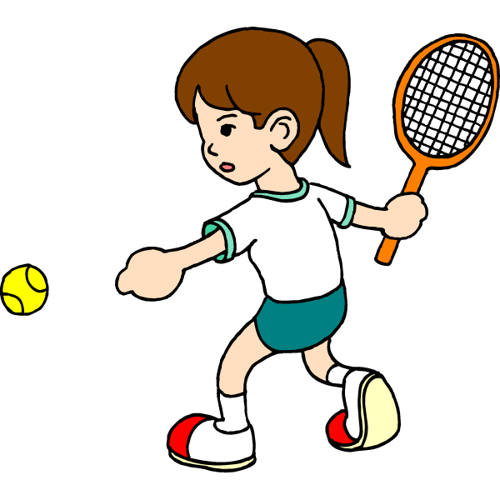
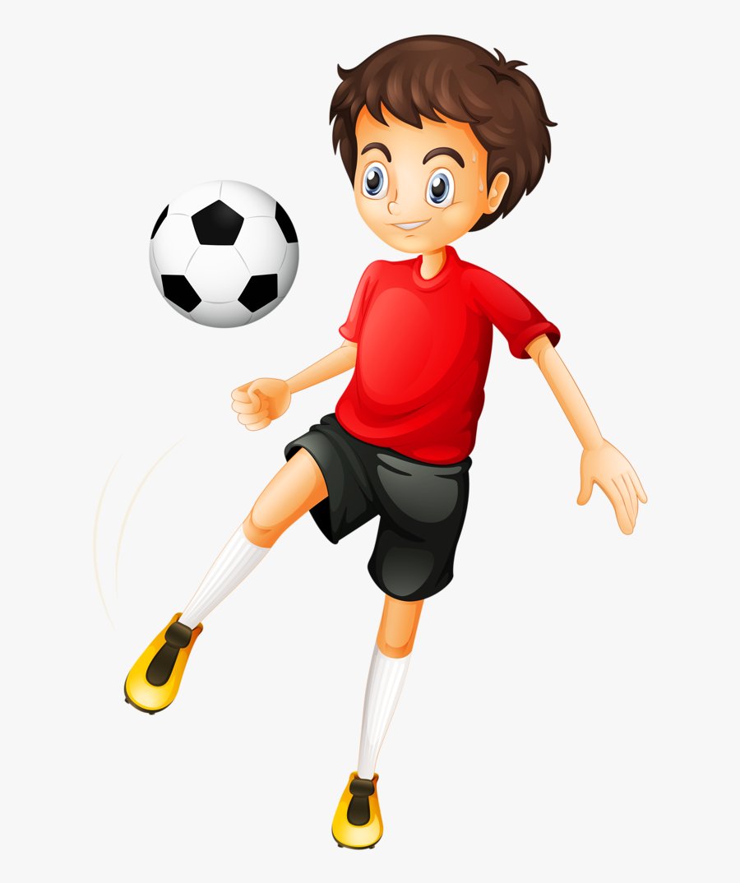
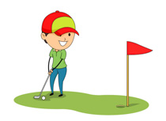
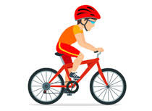
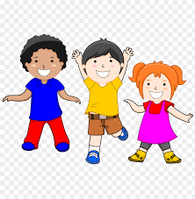
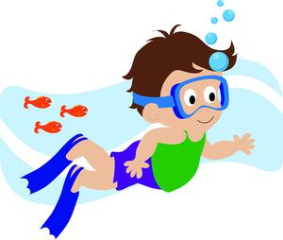
Sport
Some of us are good at being active and we may have a sporting skill. You could become a talented footballer or tennis player or swimmer or ….. Can you list some more ?

Slide 4
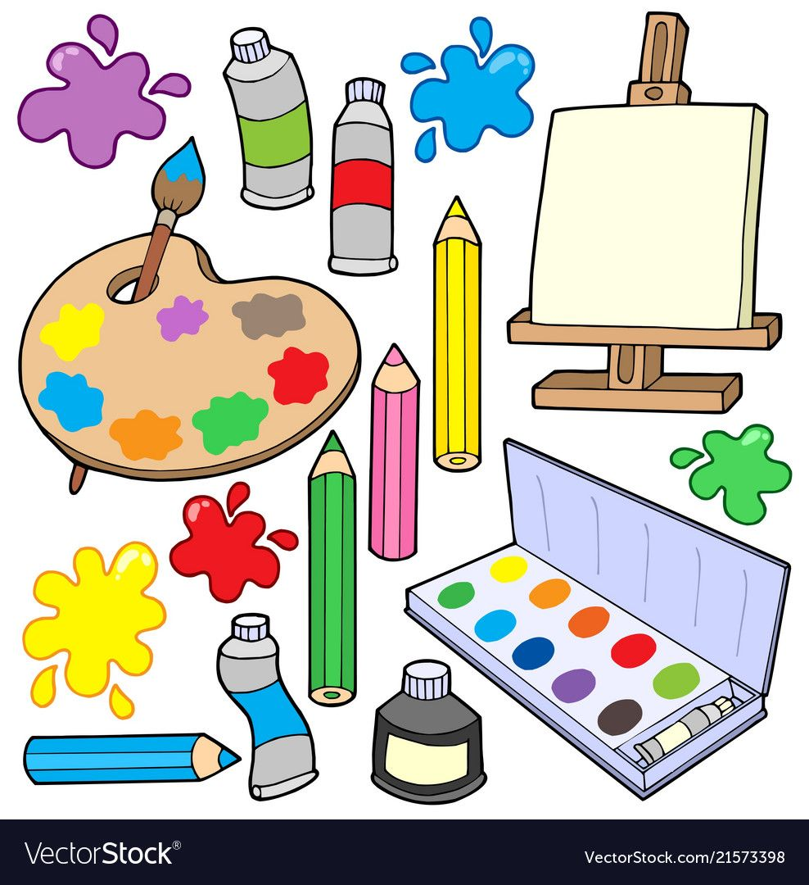
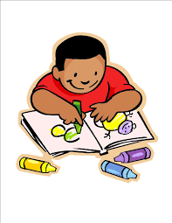
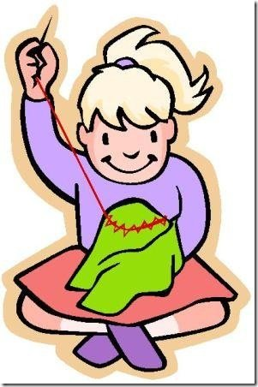
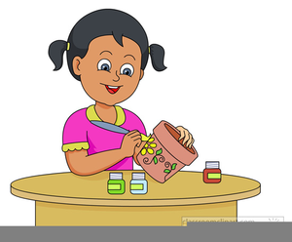
We may be artistic
You may like to draw, or paint , or cut and stick, or work with clay or collage or sew ….
Can you think of any more artistic activities ?

Slide 5
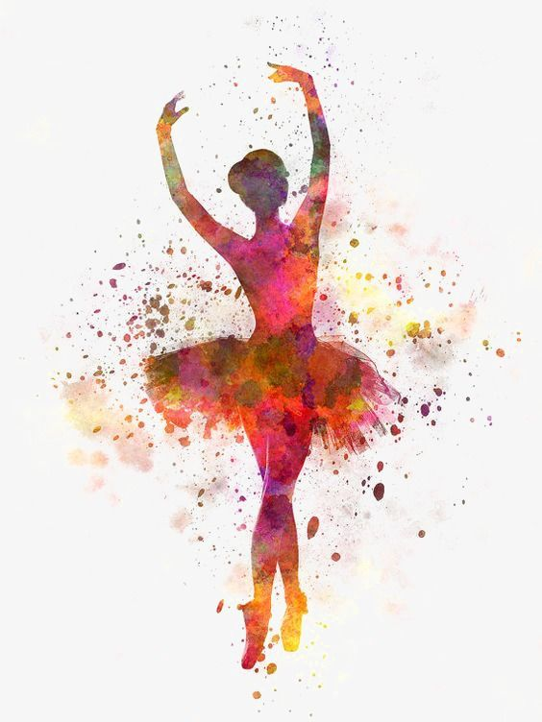
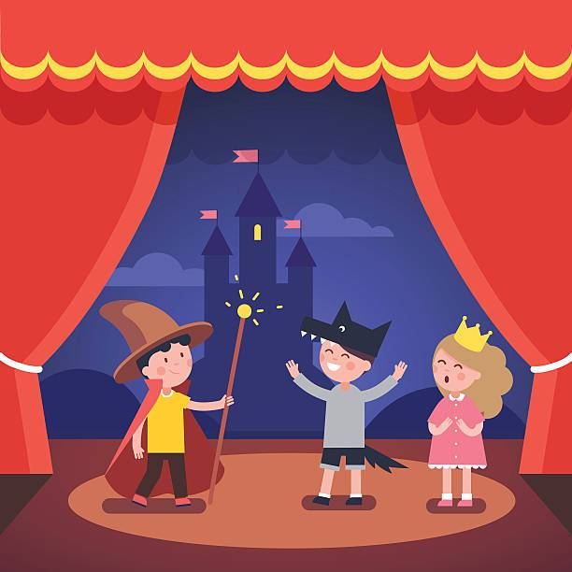
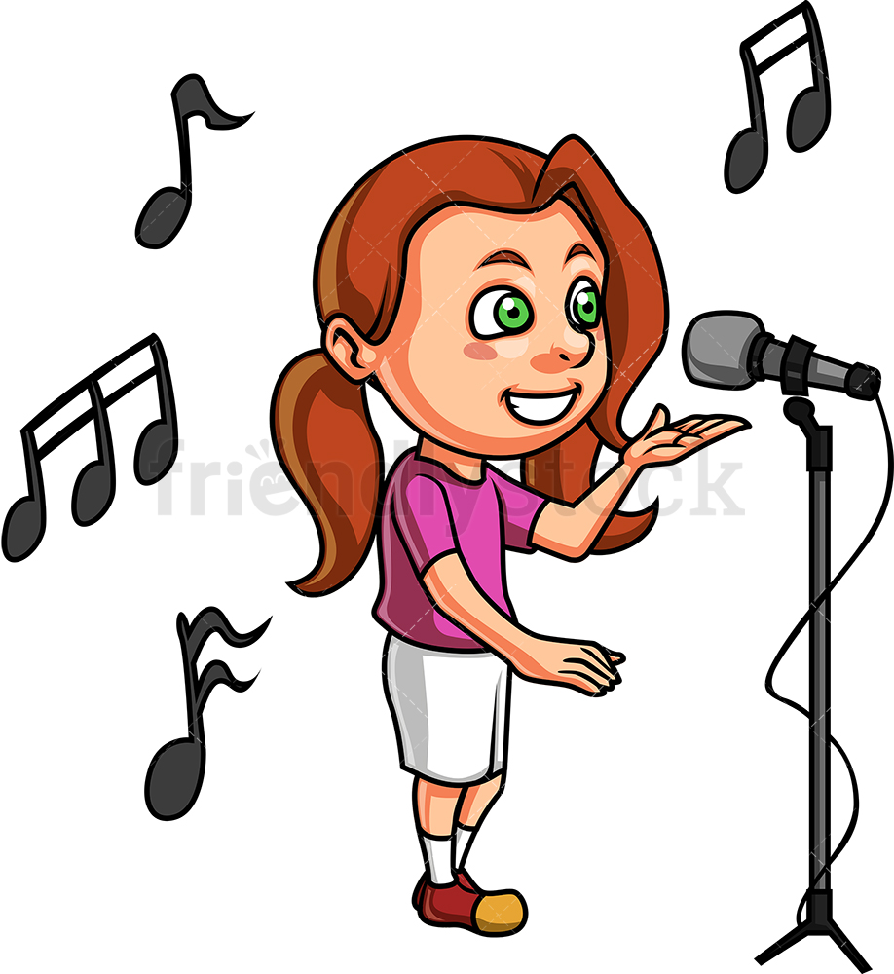
Do you like to sing or dance? Maybe you like to act or perform to people.
Perhaps you would like to learn to play a musical instrument in the future.
You could be talented at any of these activities.

Slide 6
You can develop or get better at things by practising them.
You may become so good that you become talented.

Slide 7
You can only find out what your talents are by trying new things.
Never say to yourself ‘I can’t do that’ or ‘I don’t like that’ until you have tried it out!

Slide 8
It is very exciting to think about the talents you have now and may have in the future.
I like to be active.
I am going to practise my throwing and catching – I could be talented at lots of different sports in the future.
What would you like to try out?
Read the ideas here. What would you write in the purple speech bubble?
I am going to read lots of books and try to write some stories of my own. I may be a talented writer!
I
I am going to try out singing – I like listening to music and singing along to songs. I could be a talented singer .
I might be talented at drawing and painting – it is something I like to do and I think I am quite good at it now…

Slide 9
Christians believe that God has given us all talents.
We should not waste our talents but use them to help make the world a better place and to do good things.

Slide 10
For your task this week we would like you to explore classical music.
With your grown –up please visit the website : classics for kids https://www.classicsforkids.com/composers/composer_profile.php?id=46
to answer this question:
1) How old was the composer Wolfgang Amadeus Mozart when he composed ( wrote ) his first piece of music?
2)Listen to
Piano Sonata No. 11 in A: Turkish Rondo and Variations on "Ah vous dirai-je, maman": Turkish Rondo
Which do you like best?
3) You could try to compose some of your own music using the games area of the website :
https://www.classicsforkids.com/games.html
You could be talented!

