Slide 1
Let’s talk about feelings …
Afraid

Slide 3
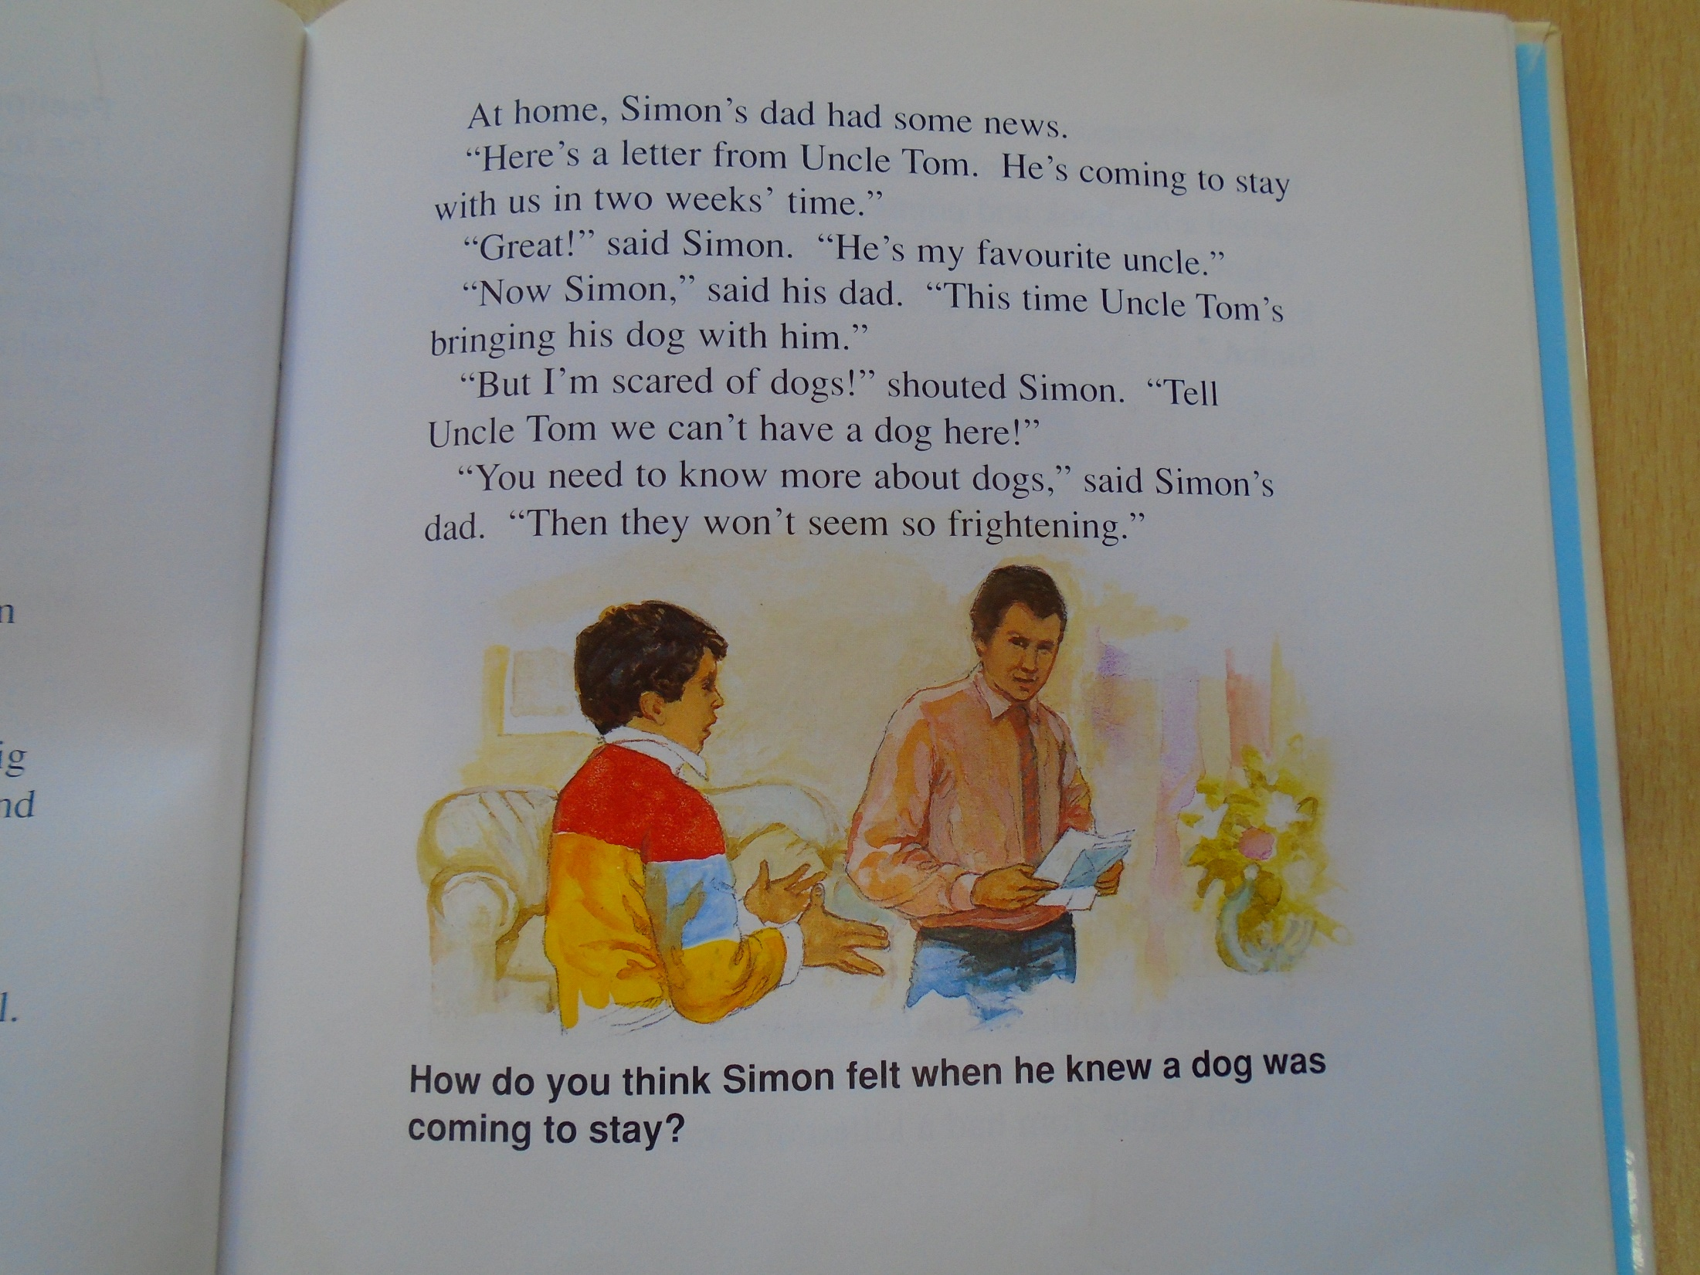

Slide 5
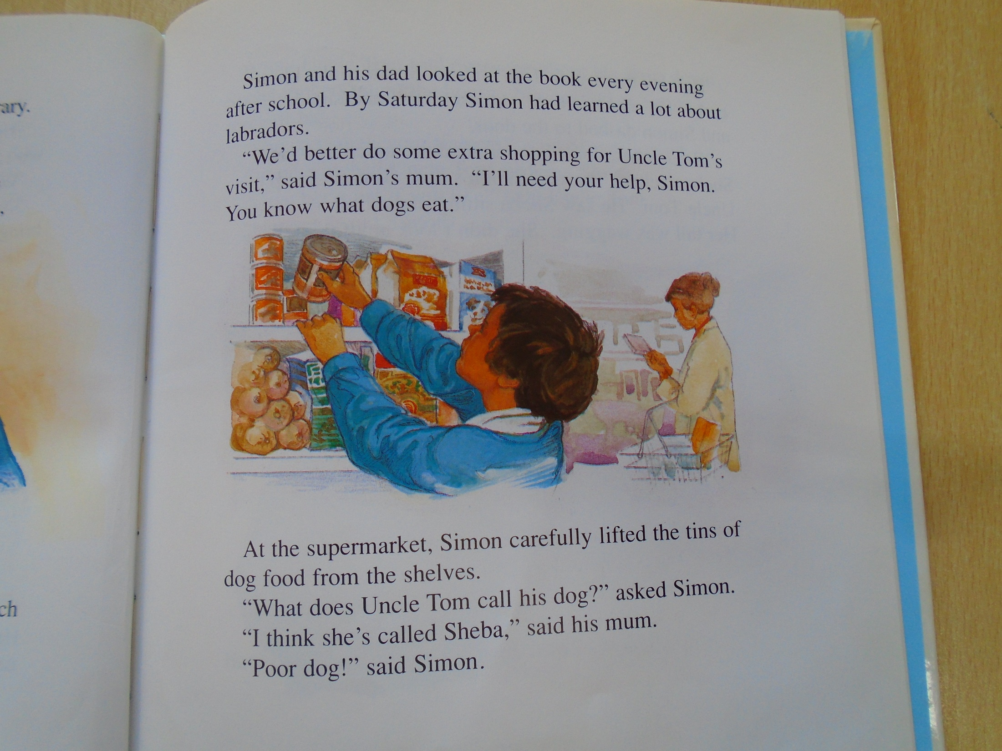

Slide 6
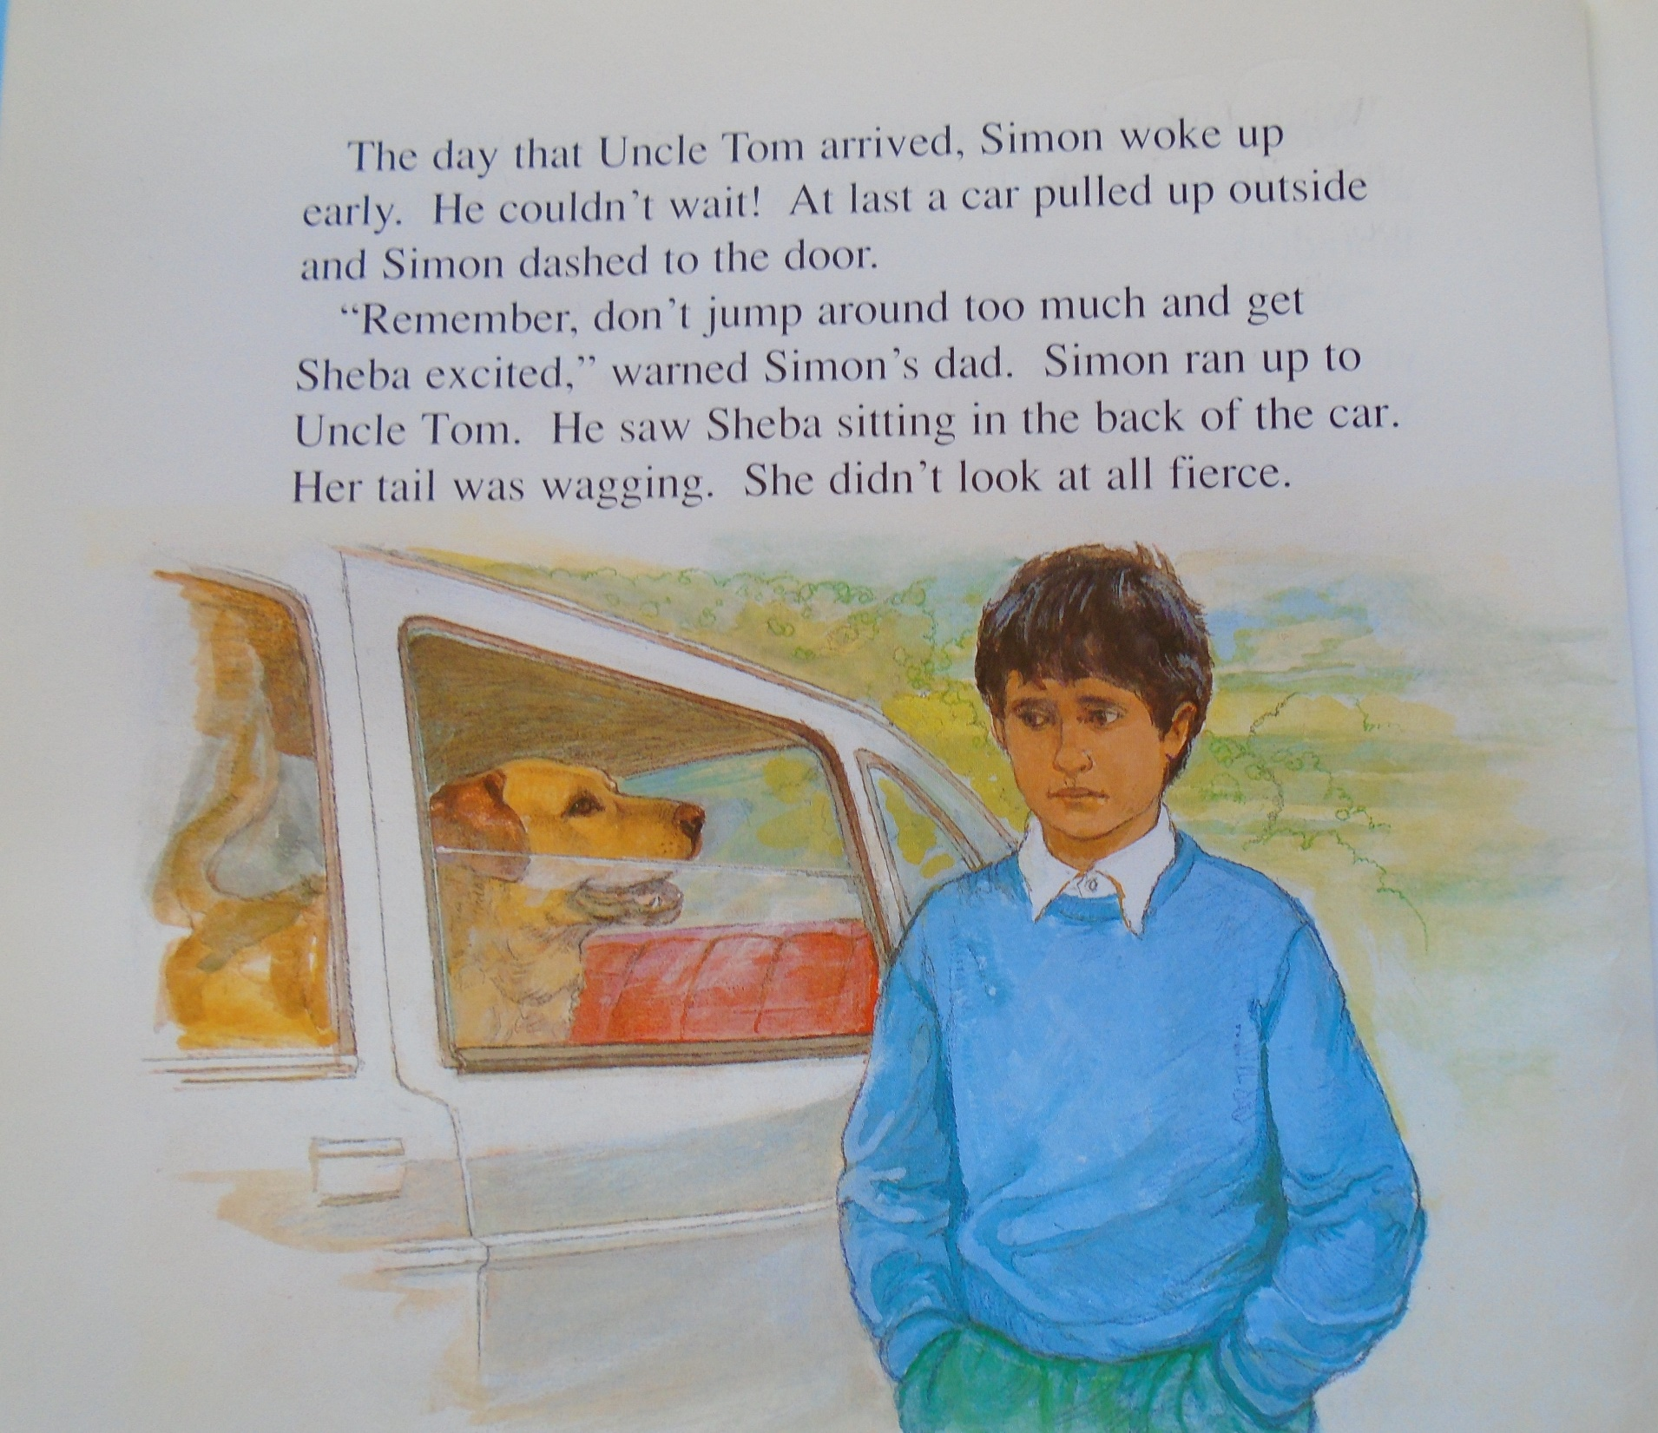

Slide 7
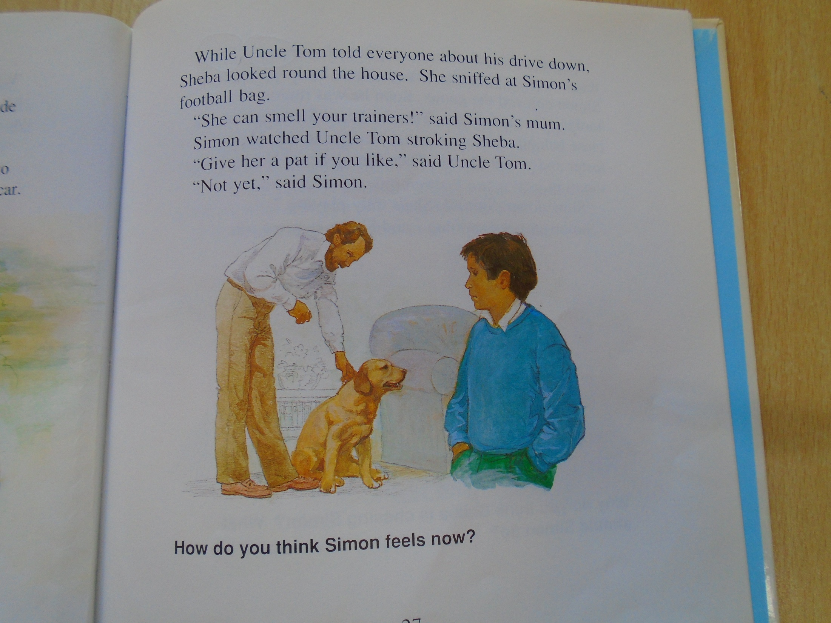

Slide 9
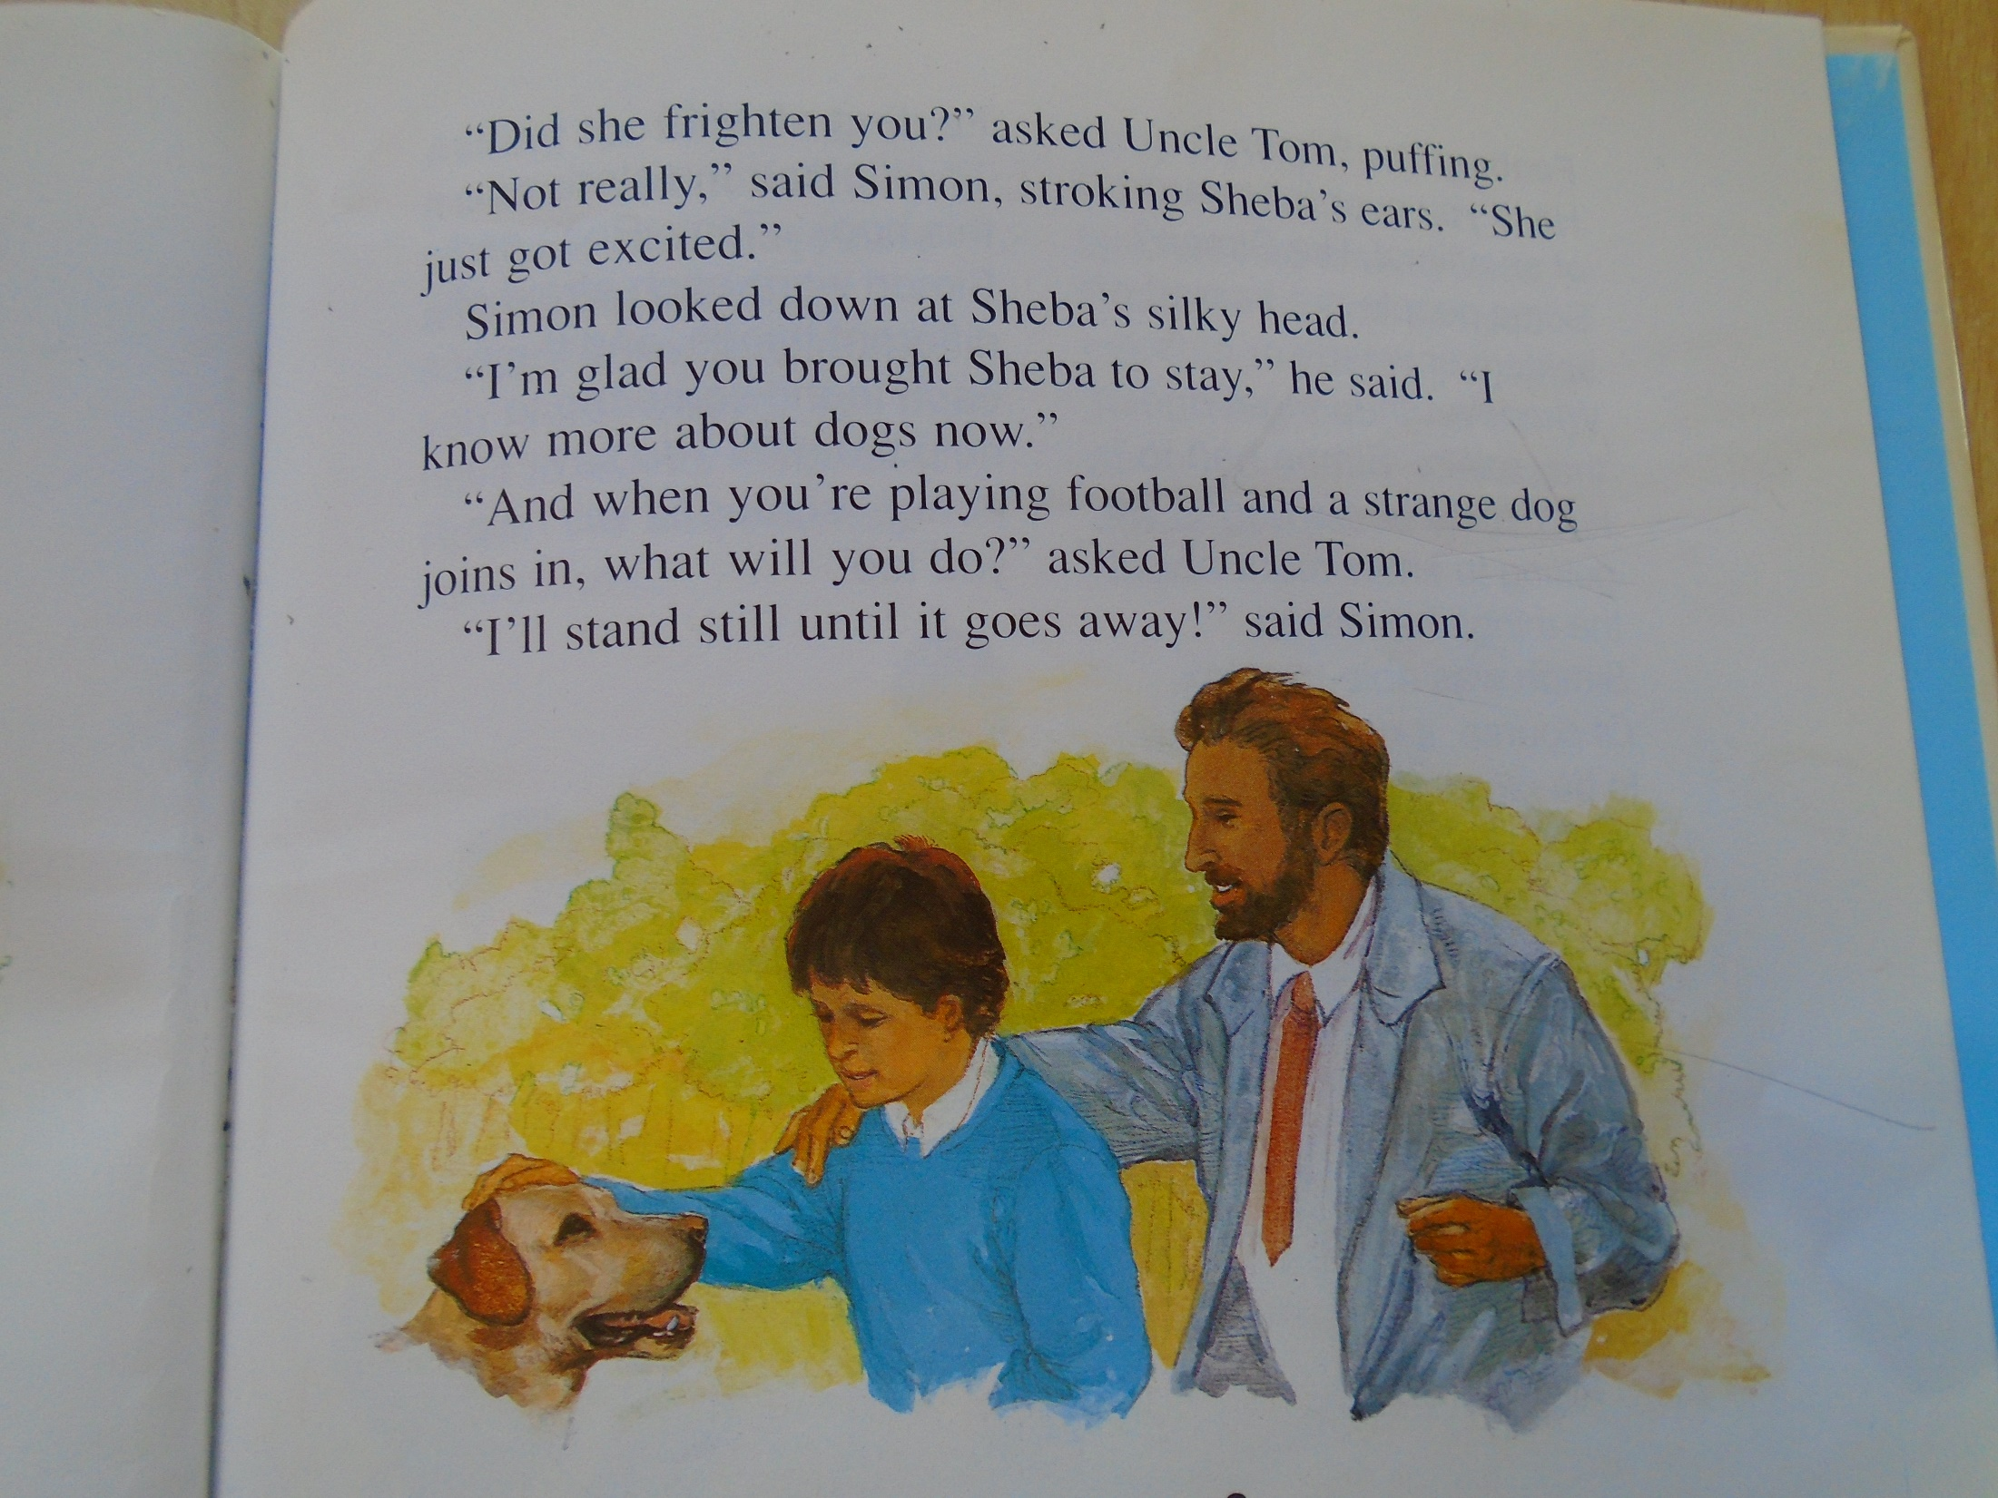

Slide 11
Asking for help
It’s often hard to tell someone else that you’re afraid. But talking to someone you trust makes you feel stronger.
You may have to ask for help.
We all need help sometimes.
Think about who you would talk to.

Slide 12
Now that you have read this story you can complete the worksheet
Simon’s Story

